Slide 1


<Andrew Srb>
<9/27/2025>

Slide 2

Outline
Executive Summary
Introduction
Methodology
Results
Conclusion
Appendix

Slide 3
Executive Summary
Analyze SpaceX launch records to identify success patterns, payload correlations, and booster performance.
Data collection via SpaceX REST API → Interactive dashboard → Predictive modeling.
Real-time insights for mission planning and strategic decision-making.
Conclusions from predictive analysis find that there’s and ~84% chance of accuracy

Slide 4
Introduction
What Determines a Successful Landing?
Key Factors We Investigated:
Payload Size – How the weight of the mission cargo influences landing outcomes
Booster Version – Differences in reliability across Falcon 9 variants
Launch Details – Timing, mission type, and mission complexity
Launch Location – Impact of site conditions (Cape Canaveral, Vandenberg, Kennedy)
Launch Distance – Orbital destination and mission trajectory
Landing Location – Ground pad vs. drone ship recovery

Slide 5

Section 1

Slide 6
Methodology
Executive Summary
Data collection methodology:
API pulls and web scraping from trusted public sources
Perform data wrangling
Launch details, orbit distance, and outcome classification
Perform exploratory data analysis (EDA) using visualization and SQL
Perform interactive visual analytics using Folium and Plotly Dash
Perform predictive analysis using classification models
Trained and tested the data set utilizing multiple methods

Slide 7
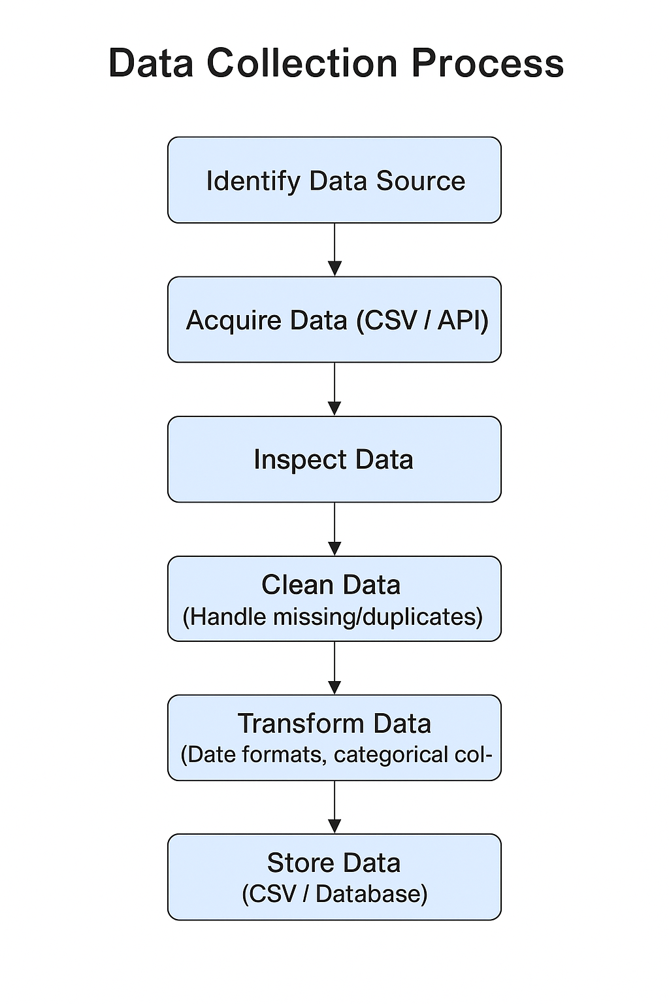
Data Collection
Source Identification: Identify reliable data sources (e.g., public SpaceX launch datasets, Kaggle, APIs).
Data Acquisition: Download CSV files or query APIs to gather structured launch data.
Data Inspection: Check column names, data types, and completeness.
Data Cleaning: Handle missing values, duplicates, and inconsistent formats.
Data Transformation: Convert dates to standard formats, categorize outcomes (success/failure).
Data Storage: Save the cleaned dataset in CSV or database for further analysis.

Slide 8
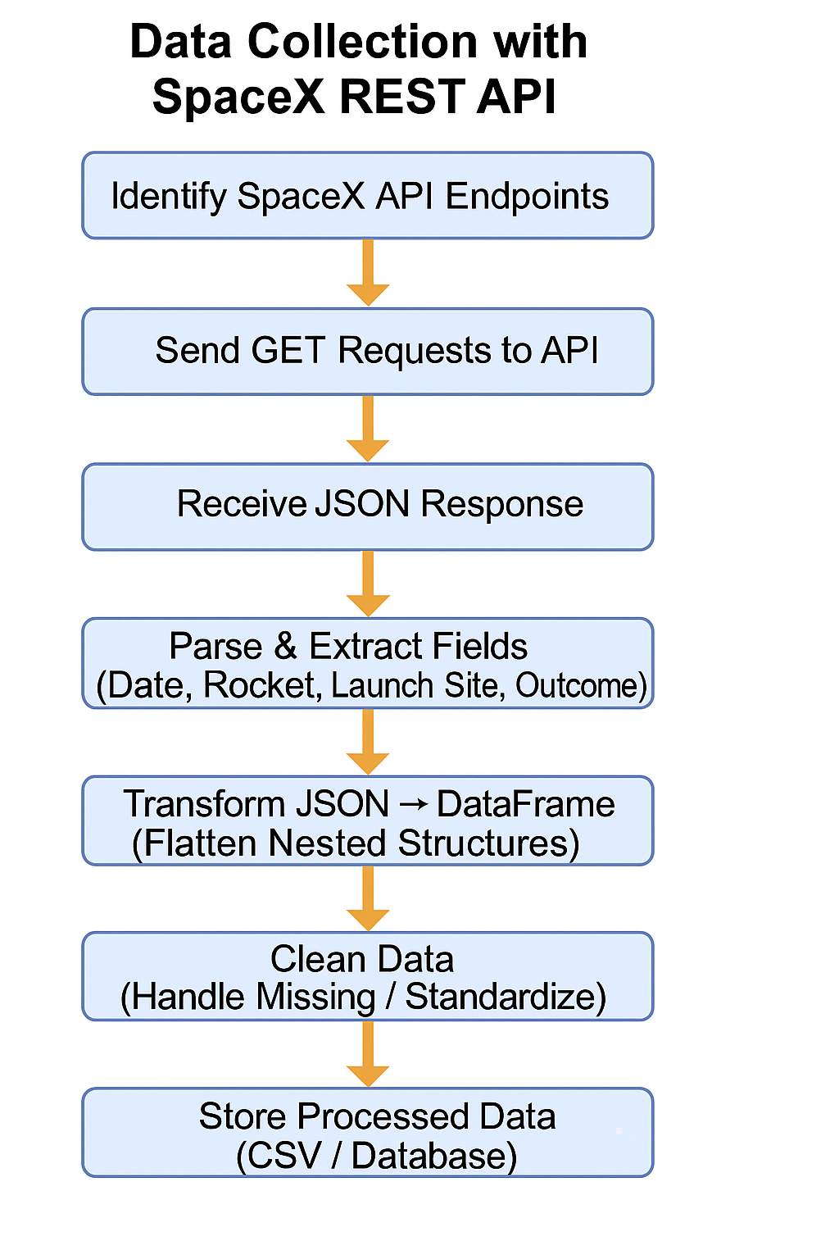
Data Collection – SpaceX API
Identify API Endpoints
Parse & Extract Fields
Important attributes: date_utc, rocket, launchpad, payloads, success
Clean Data
Handle missing values (e.g., payload mass for failed missions)
Standardize outcomes (success → 1, failure → 0)
Normalize categorical values
GitHub link

Slide 9
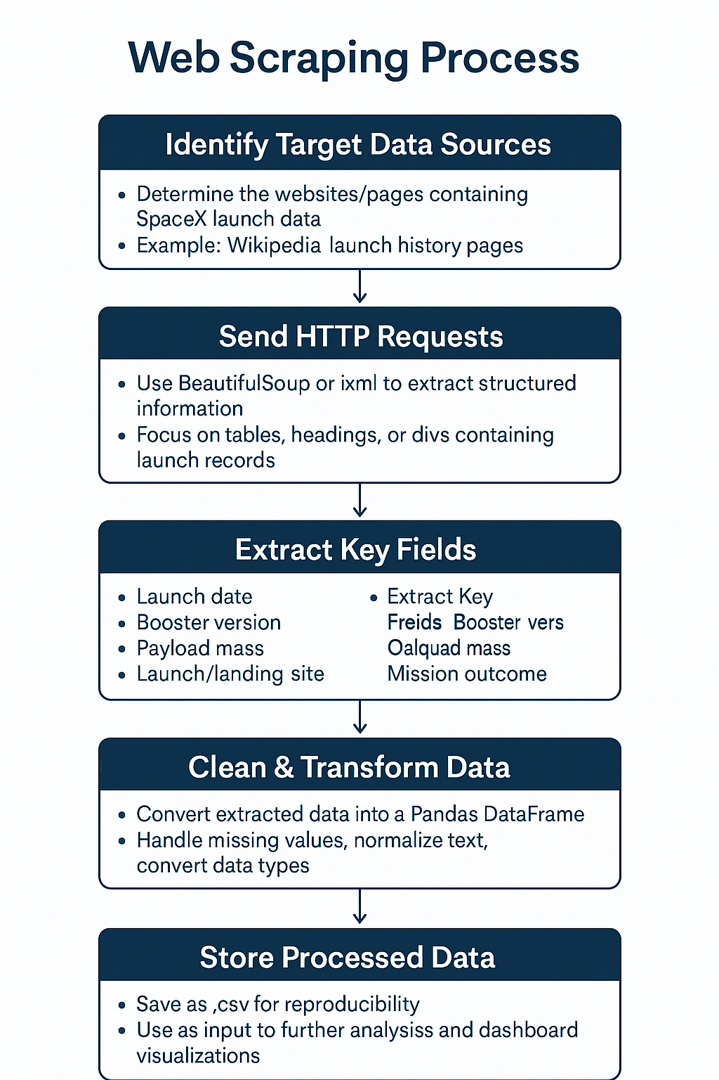
Data Collection - Scraping
Identify Target Data Source
Select websites containing SpaceX launch data (e.g., Wikipedia)
Extract Key Fields
Launch date, booster version, payload mass, launch site, outcome
Clean & Transform Data
Handle missing values, normalize text, standardize formats
Store Processed Data
GitHub Link

Slide 10
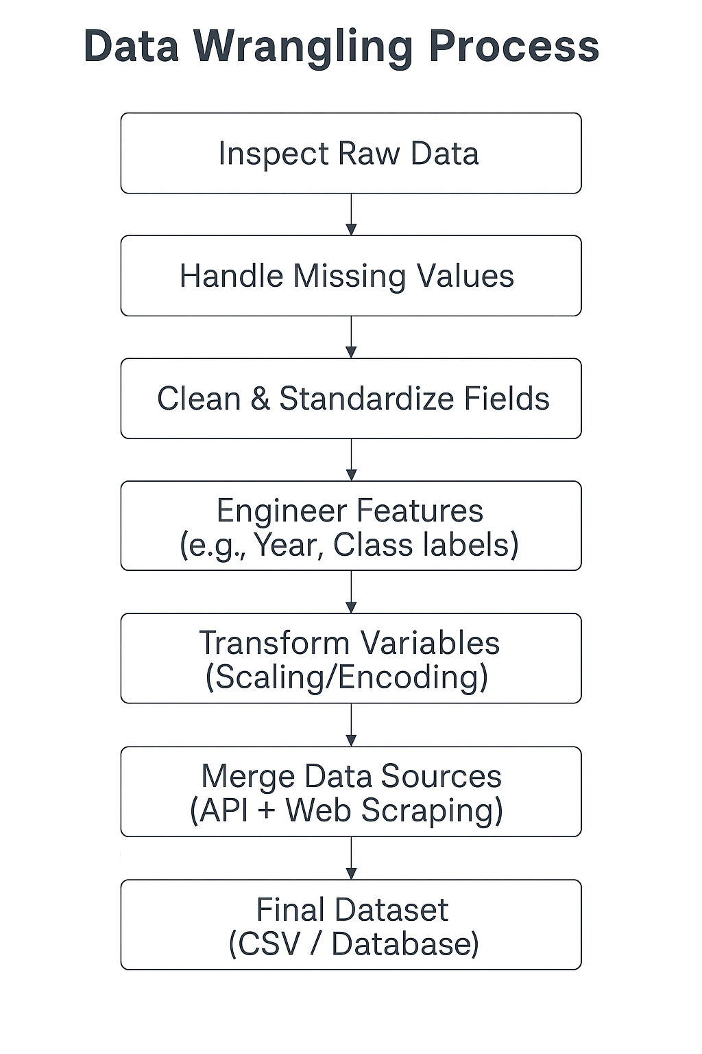
Data Wrangling
Data Inspection – Checked dataset structure, column names, and data types
Handling Missing Values – Filled or removed incomplete rows (e.g., payload mass missing for failed launches)
Data Cleaning – Standardized categorical variables (success/failure → 1/0, booster versions normalized)
Feature Engineering – Extracted year from launch date, derived launch outcome labels, and created numerical encodings for categorical fields
Data Transformation – Scaled payloads and continuous variables with StandardScaler
Data Integration – Merged API, web-scraped, and cleaned data into one consistent DataFrame
Final Storage – Saved clean dataset into .csv for analysis and dashboard use
GitHub Link

Slide 11
EDA with Data Visualization
Bar Charts - Compare success rates across orbit types
Line Charts - Track success rate trends over time (by year)
Scatter Plots - Visualize relationship between payload & outcomes, color-coded by booster version
GitHub Link

Slide 12
EDA with SQL
Filter: Launch sites starting with 'CCA'
Aggregate:
Total payload mass by NASA (CRS)
Average payload mass for F9 v1.1
Date: First successful ground pad landing
Conditional: Boosters with successful drone ship landings & payload 4000–6000
Counts: Successful vs failed mission outcomes
Subquery: Booster versions with maximum payload mass
Year/Month: Drone ship landing failures in 2015
Ranking: Landing outcomes ranked (2010–2017)
GitHub Link

Slide 13
Build an Interactive Map with Folium
Markers - Identify launch sites & coastline points
Circles - Show launch site boundaries (1 km radius)
Lines - Connect sites to coastlines/cities, show distances
DivIcon Labels - Display site names & distances directly on map
GitHub Link

Slide 14
Build a Dashboard with Plotly Dash
Pie Chart - Shows success vs. failure (per site or all sites)
Why: Easy way to compare proportions at a glance
Scatter Plot - Plots payload vs. outcome, color-coded by booster version
Why: Reveals correlations between payload size and success, and booster performance differences
Interactions:
Dropdown (Launch Site): Filter visualizations by site or view all sites
Range Slider (Payload): Filter results by payload size range
Github Link

Slide 15
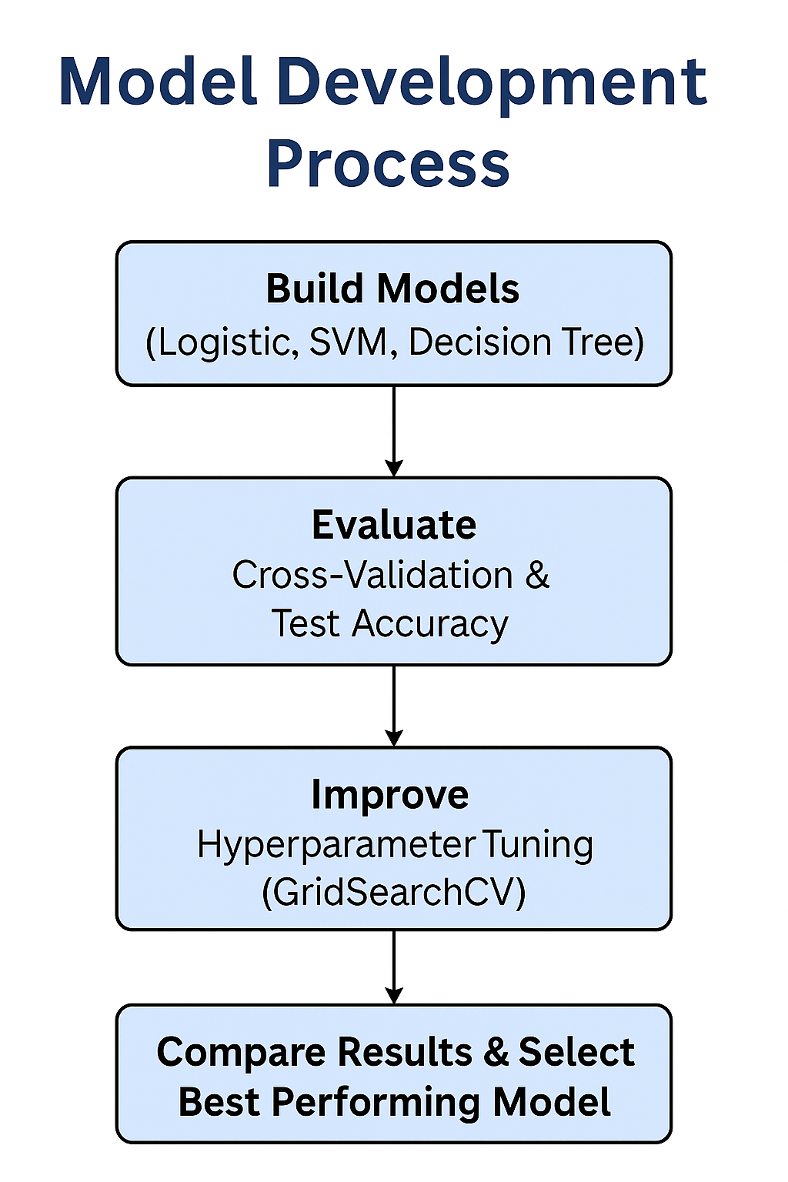
Predictive Analysis (Classification)
Build: Trained multiple classifiers (Logistic Regression, SVM, Decision Tree, KNN)
Evaluate: Used cross-validation (cv=10) and accuracy score on test set
Improve: Performed hyperparameter tuning with GridSearchCV
Select Best: Compared test accuracies, identified Decision Tree as best performer (~87%)
GitHub Link

Slide 16
Results

Slide 17

Section 2

Slide 18
Flight Number vs. Launch Site
Show a scatter plot of Flight Number vs. Launch Site
Show the screenshot of the scatter plot with explanations

Slide 19
Payload vs. Launch Site
Show a scatter plot of Payload vs. Launch Site
Show the screenshot of the scatter plot with explanations

Slide 20
Success Rate vs. Orbit Type
Show a bar chart for the success rate of each orbit type
Show the screenshot of the scatter plot with explanations

Slide 21
Flight Number vs. Orbit Type
Show a scatter point of Flight number vs. Orbit type
Show the screenshot of the scatter plot with explanations

Slide 22
Payload vs. Orbit Type
Show a scatter point of payload vs. orbit type
Show the screenshot of the scatter plot with explanations

Slide 23
Launch Success Yearly Trend
Show a line chart of yearly average success rate
Show the screenshot of the scatter plot with explanations

Slide 24
All Launch Site Names
Find the names of the unique launch sites
Present your query result with a short explanation here

Slide 25
Launch Site Names Begin with 'CCA'
Find 5 records where launch sites begin with `CCA`
Present your query result with a short explanation here

Slide 26
Total Payload Mass
Calculate the total payload carried by boosters from NASA
Present your query result with a short explanation here

Slide 27
Average Payload Mass by F9 v1.1
Calculate the average payload mass carried by booster version F9 v1.1
Present your query result with a short explanation here

Slide 28
First Successful Ground Landing Date
Find the dates of the first successful landing outcome on ground pad
Present your query result with a short explanation here

Slide 29
Successful Drone Ship Landing with Payload between 4000 and 6000
List the names of boosters which have successfully landed on drone ship and had payload mass greater than 4000 but less than 6000
Present your query result with a short explanation here

Slide 30
Total Number of Successful and Failure Mission Outcomes
Calculate the total number of successful and failure mission outcomes
Present your query result with a short explanation here

Slide 31
Boosters Carried Maximum Payload
List the names of the booster which have carried the maximum payload mass
Present your query result with a short explanation here

Slide 32
2015 Launch Records
List the failed landing_outcomes in drone ship, their booster versions, and launch site names for in year 2015
Present your query result with a short explanation here

Slide 33
Rank Landing Outcomes Between 2010-06-04 and 2017-03-20
Rank the count of landing outcomes (such as Failure (drone ship) or Success (ground pad)) between the date 2010-06-04 and 2017-03-20, in descending order
Present your query result with a short explanation here

Slide 34

Section 3

Slide 35
<Folium Map Screenshot 1>
Replace <Folium map screenshot 1> title with an appropriate title
Explore the generated folium map and make a proper screenshot to include all launch sites’ location markers on a global map
Explain the important elements and findings on the screenshot

Slide 36
<Folium Map Screenshot 2>
Replace <Folium map screenshot 2> title with an appropriate title
Explore the folium map and make a proper screenshot to show the color-labeled launch outcomes on the map
Explain the important elements and findings on the screenshot

Slide 37
<Folium Map Screenshot 3>
Replace <Folium map screenshot 3> title with an appropriate title
Explore the generated folium map and show the screenshot of a selected launch site to its proximities such as railway, highway, coastline, with distance calculated and displayed
Explain the important elements and findings on the screenshot

Slide 38

Section 4

Slide 39
<Dashboard Screenshot 1>
Replace <Dashboard screenshot 1> title with an appropriate title
Show the screenshot of launch success count for all sites, in a piechart
Explain the important elements and findings on the screenshot

Slide 40
<Dashboard Screenshot 2>
Replace <Dashboard screenshot 2> title with an appropriate title
Show the screenshot of the piechart for the launch site with highest launch success ratio
Explain the important elements and findings on the screenshot

Slide 41
<Dashboard Screenshot 3>
Replace <Dashboard screenshot 3> title with an appropriate title
Show screenshots of Payload vs. Launch Outcome scatter plot for all sites, with different payload selected in the range slider
Explain the important elements and findings on the screenshot, such as which payload range or booster version have the largest success rate, etc.

Slide 42

Section 5

Slide 43
Classification Accuracy
Visualize the built model accuracy for all built classification models, in a bar chart
Find which model has the highest classification accuracy

Slide 44
Confusion Matrix
Show the confusion matrix of the best performing model with an explanation

Slide 45
Conclusions
Point 1
Point 2
Point 3
Point 4
…

Slide 46
Appendix
Include any relevant assets like Python code snippets, SQL queries, charts, Notebook outputs, or data sets that you may have created during this project

Slide 47


